Slide 1
FRIEND
Human Emotion Detection and Emotion-Aware Chatbot Using Computer Vision and AI
By,
Anto Jebin
Bharath venancious
Muhammad Awf
Sharooq Ahmed

Slide 2
PROBLEM STATEMENT
📝 Content
Many people experience stress, sadness, and anger but do not express it openly
Traditional chatbots respond without understanding emotions
Manual emotion detection is not scalable and inaccurate
👉 There is a need for a system that can automatically understand human emotions using facial expressions and text.

Slide 3
OBJECTIVES OF THE PROJECT
📝 Content
Detect human emotions using live webcam video
Analyze emotions from user text messages
Classify emotions such as:
  Happy, Sad, Angry, Neutral
Provide emotion-based chatbot responses
Convert negative emotions into positive mood

Slide 4
SYSTEM OVERVIEW
📝 Content
The system works in three major stages:
Input Layer
  Live camera feed
  User text input
Processing Layer
  Face detection
  Emotion classification
Response Layer
  Chatbot replies based on emotion

Slide 5
TECHNOLOGIES USED
📝 Content
Python – Core programming language
OpenCV – Live video capture & face detection
Streamlit – Web-based user interface
Deep Learning Model – Emotion classification
NumPy – Image and data processing

Slide 6
SYSTEM ARCHITECTURE
Text:
Input Layer: Camera + Text
Processing Layer: Face & Emotion Modules
Output Layer: Emotion + Response

Slide 7
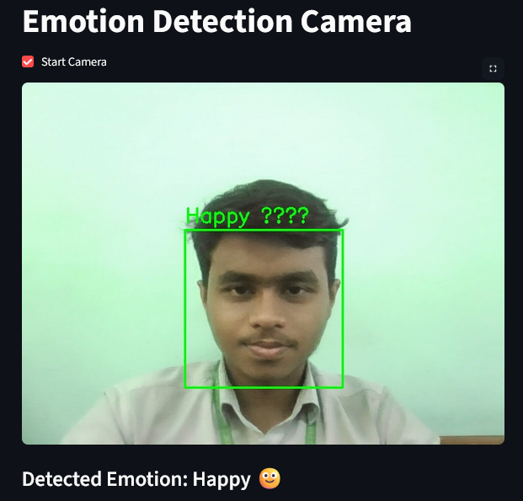
Face & Emotion Detection
Text:
OpenCV for face detection
Emotion classified from facial expressions
Green bounding box on detected face

Slide 8
Chatbot Design
Text:
Accepts user text input
Uses detected emotion as context
Generates empathetic responses

Slide 9
Implementation & Tools
Text:
Python
OpenCV
Streamlit
NumPy

Slide 10
Results & Applications
Text:
Real-time emotion detection achieved
Stable performance on low-end system

Slide 11
Conclusion & Future Scope
Text:
Emotion-aware interaction achieved
Improves user experience
Future:
Voice emotion detection
Deep learning models
Mobile deployment

